Slide 1
Chongqing University of Technology
ATAI
Advanced Technique of Artificial Intelligence
Chongqing University of Technology
Encoding History with Context-aware Representation Learning for Personalized Search
Yujia Zhou, Zhicheng Dou and Ji-Rong Wen (SIGIR2020)
2020.11.1 • ChongQing
Reported by Xinsheng Wang

Slide 2
Chongqing University of Technology
ATAI
Advanced Technique of Artificial Intelligence
Chongqing University of Technology
1.Introduction
2.Method
3.Experiments
4.Conclusion

Slide 3
Introduction
Most of existing studies focus on building user profiles according to user historical data, and highlighted the relevant part based on the current query to re-rank the candidate documents.
The writers aim to abandon the establishment of user profile. Instead writers regard the historical data as contextual information to refine the representation of the current query.
The writers propose a context-aware neural retrieval model, which incorporates rich contextual information including query terms, short-term history, and long-term history to refine the representation of the current query.
Paper url : https://doi.org/10.1145/3397271.3401175

Slide 4
Method
(1) The parameters and model
H = { H^{S}, H^{L} }
the query disambiguation model
a context-aware neural retrieval model
the personalized language model

Slide 5
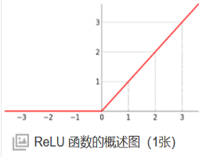
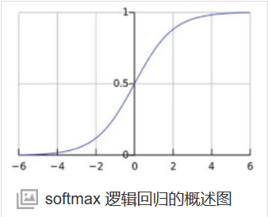
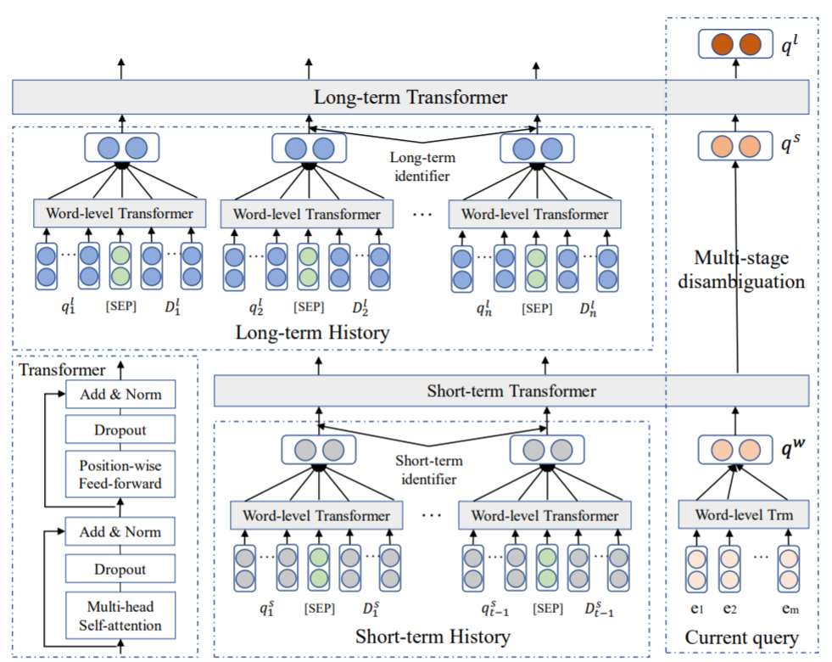
Method
(1)
(2) The query disambiguation model
(2)
(3)
Wº是模型训练中得到的参数，维度为d*d
(4)
W是模型训练中得到的参数，维度为d*d/h
(5)
(6)
为了减小下游计算成本，这里将e_{i}^{w}进行加和处理
Notes:
输入序列X经过word embedding和positional encoding做直接加和后，作为Encoder部分的输入。输入向量经过一个multi-head self-attention层后，做一次residual connection（残差连接）和Layer Normalization（层归一化，下文中简称LN），输入到下一层position-wise feed-forward network中。之后再进行一次残差连接+LN，输出到Decoder部分
scaled dot-product attention
为什么要进行scaled? https://blog.csdn.net/qq_37430422/article/details/105042303
dropout丢弃的是什么（防止过度拟合） https://www.zhihu.com/question/314260282/answer/796953696

Slide 6
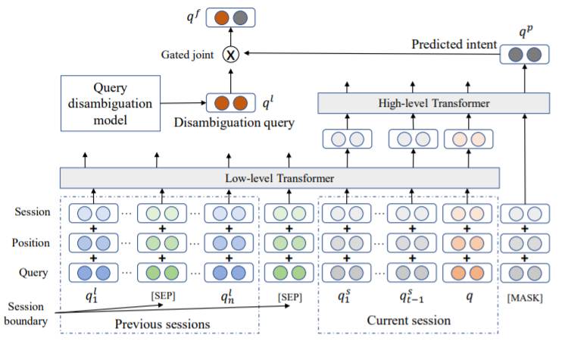
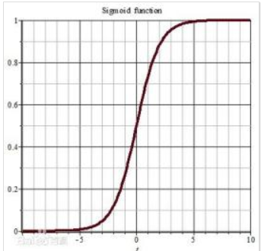
Method
(3) The personalized language model
(1)
(2)
(3)
(4)
激活函数为sigmoid

Slide 7
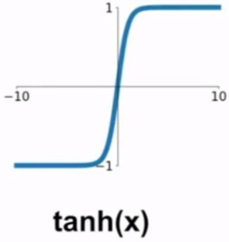
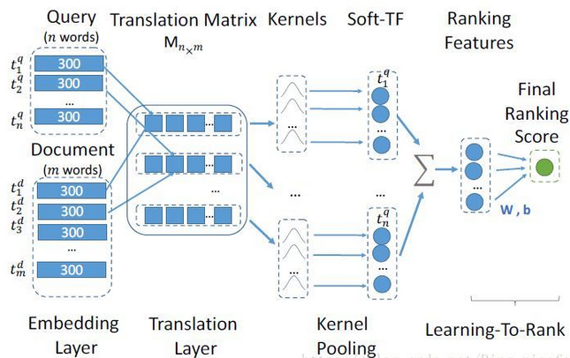
Method
(4) Re-ranking Search Results
(1)
激活函数为tanh
(2)
、
(3)
(4)
(5)

Slide 8
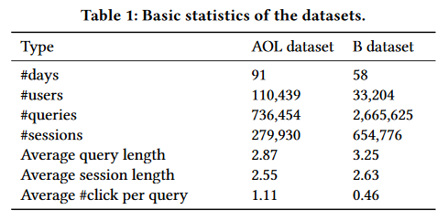
Method
(4) Training and Optimization

Slide 9
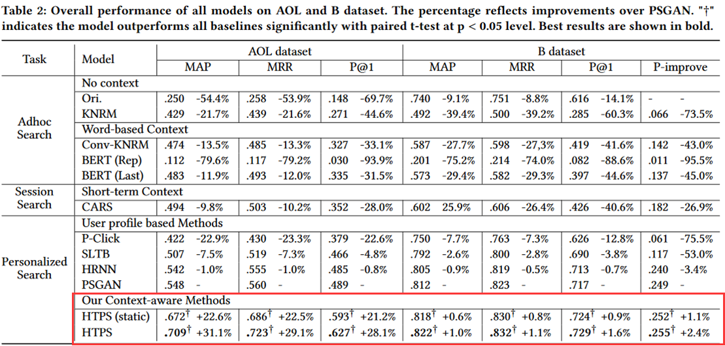
Experiments

Slide 10
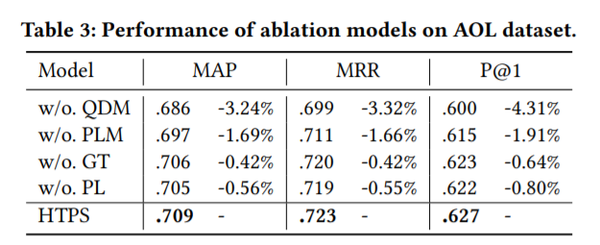
Experiments

Slide 11
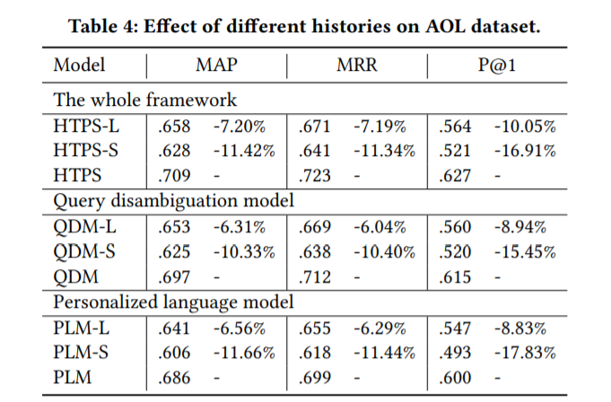
Experiments

Slide 12
Conclusion
A multi-stage query disambiguation model to parse the meaning of the current query.
A personalized language model is constructed to predict user intent based on existing queries.
These two sub-models are implemented by hierarchical transformer to encode rich contextual information.
After gated joint of them, two loss functions to optimize the whole framework.

Slide 13
Thank you!

